Slide 1
Machine Learning Midterm
Ho Huu An – 521H0489
Tran Nhut Anh – 521H0491
Do Minh Quan – 521HH0290

Slide 2
Agendas
Chapter 1 : 4 Machine Learning Algorithms
KNN
Linear Regression
Naïve Bayes
Decision Tree
Chapter 2 : select one problem and its data and solve it using Machine Learning
Overview of Data problem
Data Preprocessing
Model Building
Chapter 3 : Overfitting
Definition
Methods for reducing Overfitting

Slide 3
KNN K-NEAREST NEIGHBORS
K-Nearest Neighbors (KNN) is a simple and intuitive supervised machine learning algorithm used for classification and regression tasks. It's a non-parametric, instance-based learning algorithm, meaning it doesn't make any assumptions about the underlying data distribution and relies on the entire dataset for making predictions. KNN is easy to understand and implement, making it a good choice for various machine learning tasks.
Distance metric: such as Euclidean distance, Manhattan distance, or cosine similarity, based on the characteristics of data.
The value of K: representing the number of nearest neighbors to consider. Experiment with different values to find the optimal balance between bias and variance.
Preprocessing data: handling missing values, normalizing or standardizing features, encoding categorical variables, and reducing dimensionality if needed.
Size and complexity of the dataset: KNN models can be computationally expensive to train, especially for large and complex datasets.

Slide 4
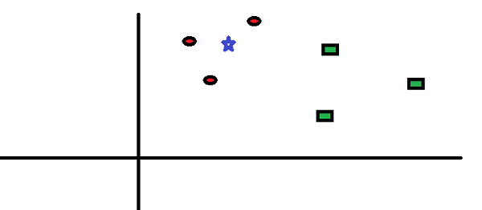
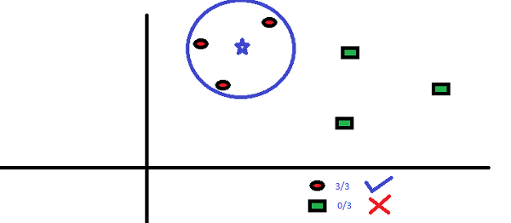
How Does the KNN Algorithm Work?

Slide 5
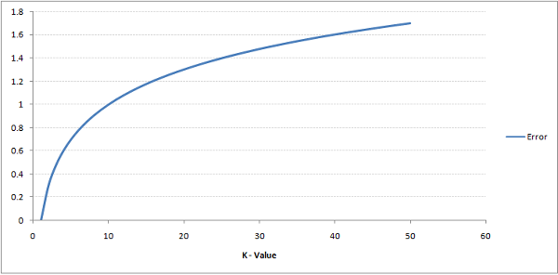
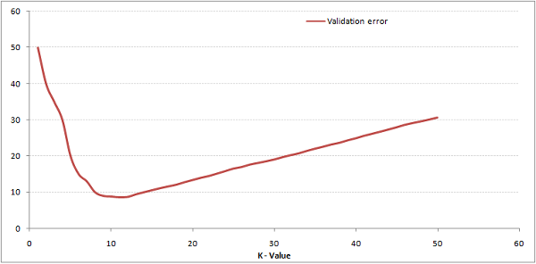
How Do We Choose the Factor K?
The error rate at K=1 is always zero for the training sample. This is because the closest point to any training data point is itself. Hence the prediction is always accurate with K=1
At K=1, we were overfitting the boundaries. Hence, error rate initially decreases and reaches a minima. After the minima point, it then increase with increasing K. To get the optimal value of K, you can segregate the training and validation from the initial dataset. Now plot the validation error curve to get the optimal value of K. This value of K should be used for all predictions.

Slide 6
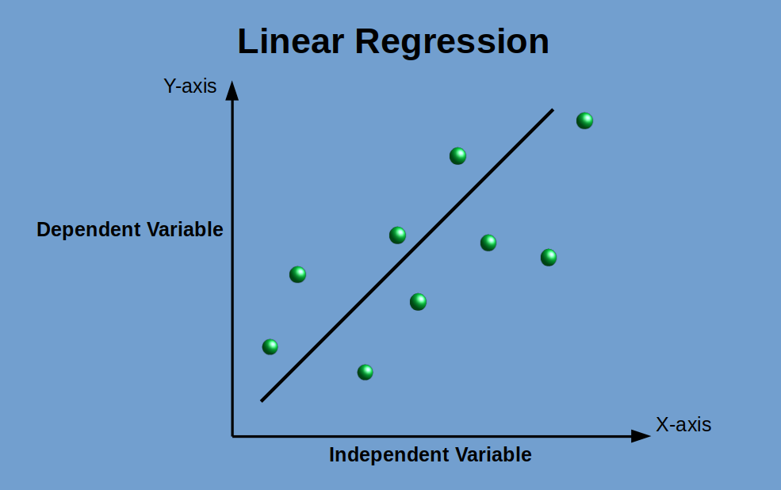
LINEAR REGRESSION
Linear regression analysis is a statistical approach used to estimate or predict the value of one variable based on the value of another variable. The variable being predicted is referred to as the dependent variable, while the variable used for prediction is known as the independent variable.Finds a linear relationship between input and output variables
Used for prediction, forecasting, relationship analysis
Advantages: interpretable, efficient computation. Disadvantages: assumes linearity, sensitive to outliers

Slide 7
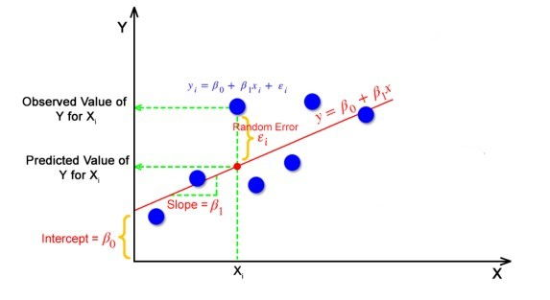
LINEAR REGRESSION
Y_{i} = β₀ + β₁X_{i}
Y_{i} = Dependent variable,
β₀ = constant/Intercept,
β₁ = Slope/Intercept,
X_{i} = Independent variable.
The goal of the linear regression algorithm is to get the best values for B₀ and B₁ to find the best fit line. The best fit line is a line that has the least error which means the error between predicted values and actual values should be minimum.

Slide 8
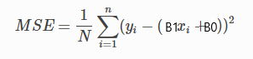
LINEAR REGRESSION
Cost Function
In Linear Regression, generally Mean Squared Error (MSE) cost function is used, which is the average of squared error that occurred between the y_{predicted} and y_{i}.

Slide 9
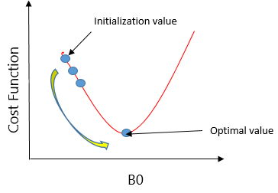
LINEAR REGRESSION
Gradient Descent
A regression model optimizes the gradient descent algorithm to update the coefficients of the line by reducing the cost function by randomly selecting coefficient values and then iteratively updating the values to reach the minimum cost function.

Slide 10
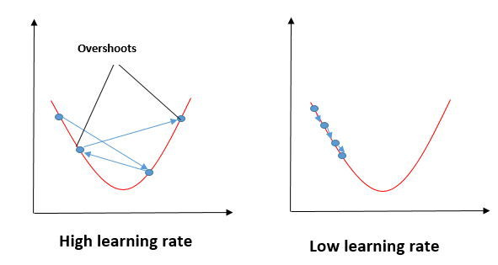
LINEAR REGRESSION
Gradient Descent
In the gradient descent algorithm, the number of steps you’re taking can be considered as the learning rate, and this decides how fast the algorithm converges to the minima.

Slide 11
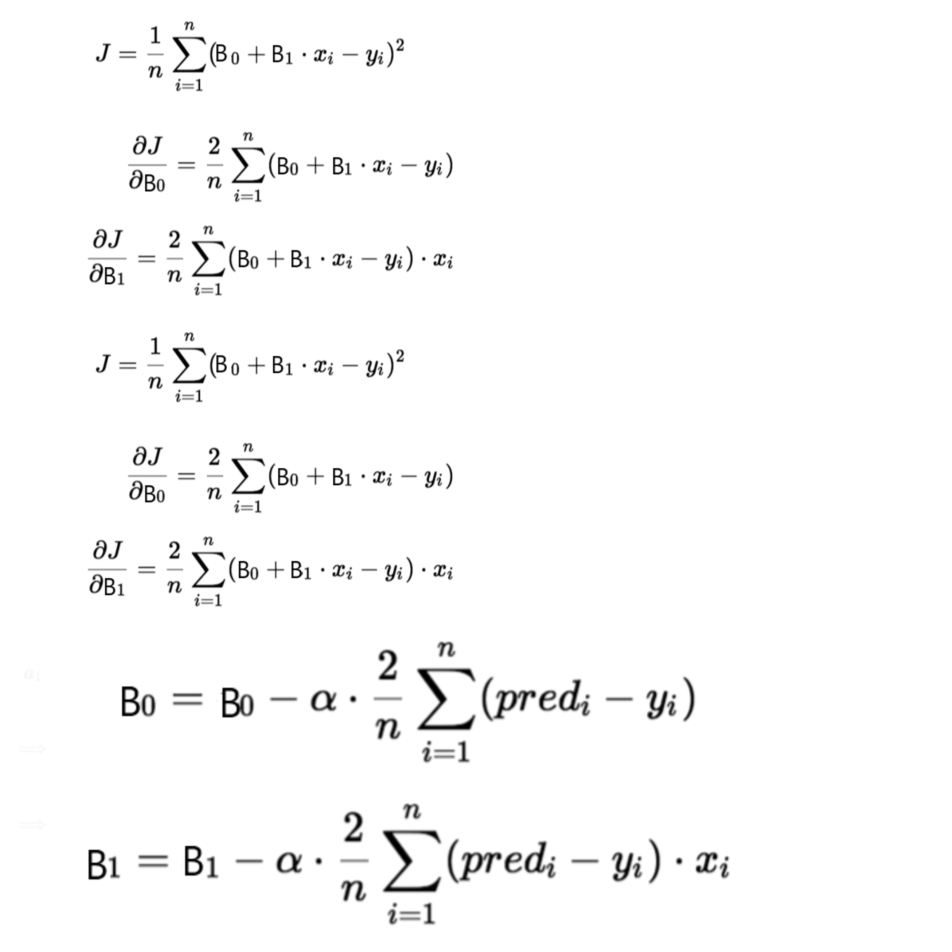
Gradient Descent
To update B₀ and B₁, we take gradients from the cost function. To find these gradients, we take partial derivatives for B0 and B1.

Slide 12
NAIVE BAYES CLASSIFIERS
The goal of creating a Naive Bayes model in machine learning is to build a classifier that can predict the class labels of input data based on their features. It uses Bayes' theorem and assumes independence between the features. The steps to create a Naive Bayes model involve data preprocessing, training the model using the training data, and evaluating its performance using test data.
Used for text classification, spam filtering, sentiment analysis
Advantages: computationally fast, handles high-dimensional data. Disadvantages: relies on independence assumption

Slide 13
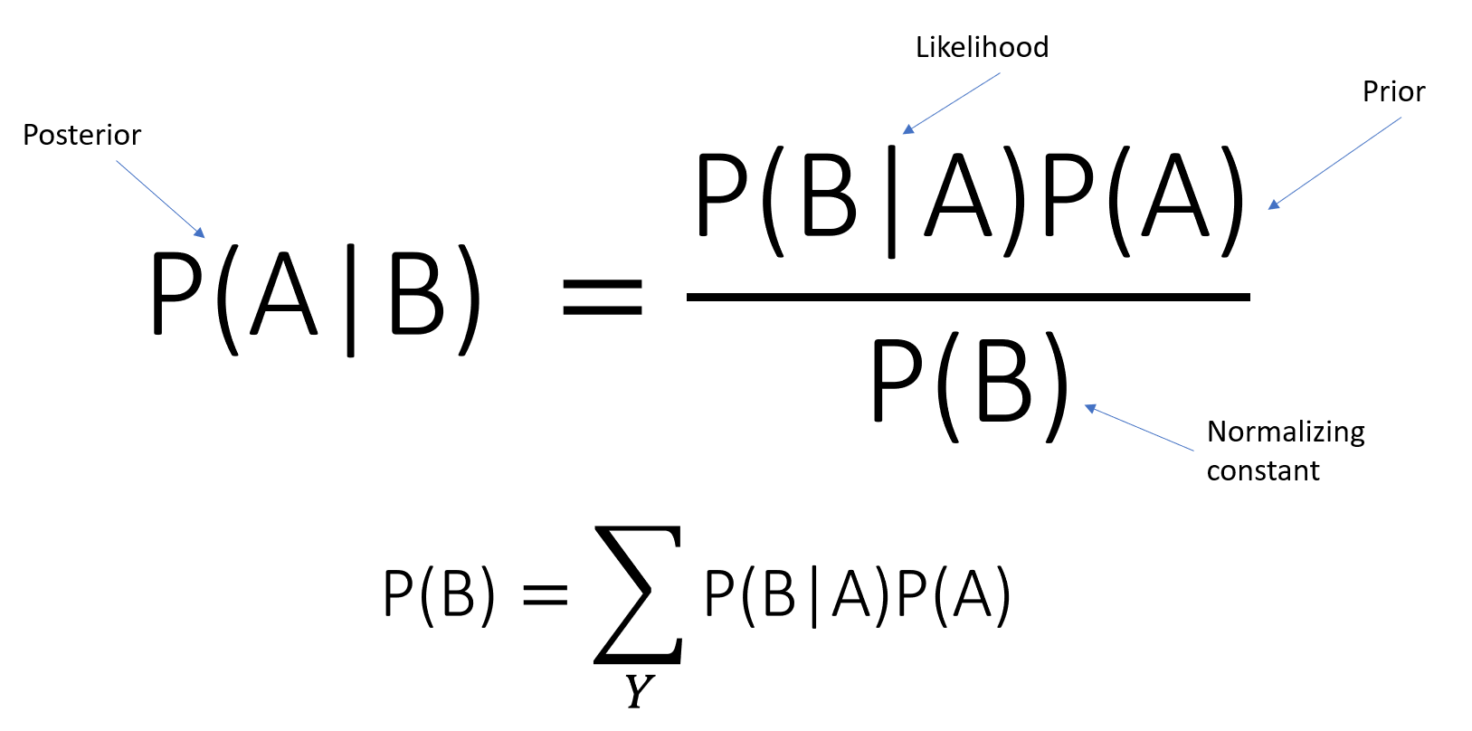
NAIVE BAYES CLASSIFIERS
B : is the input
A : is the label output
Using laplace correction

Slide 14
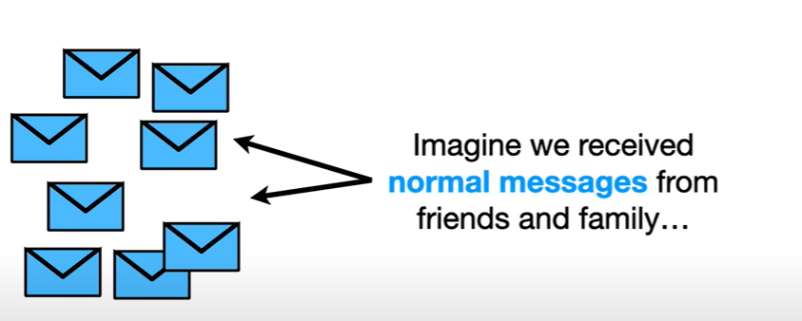
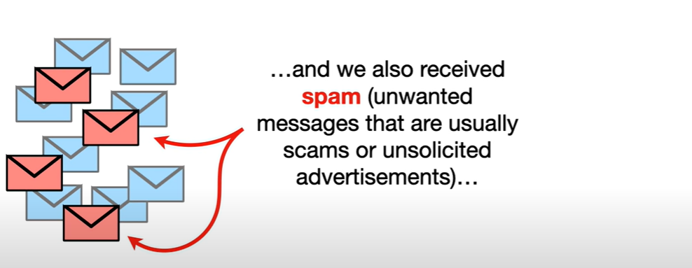
NAIVE BAYES CLASSIFIERS

Slide 15
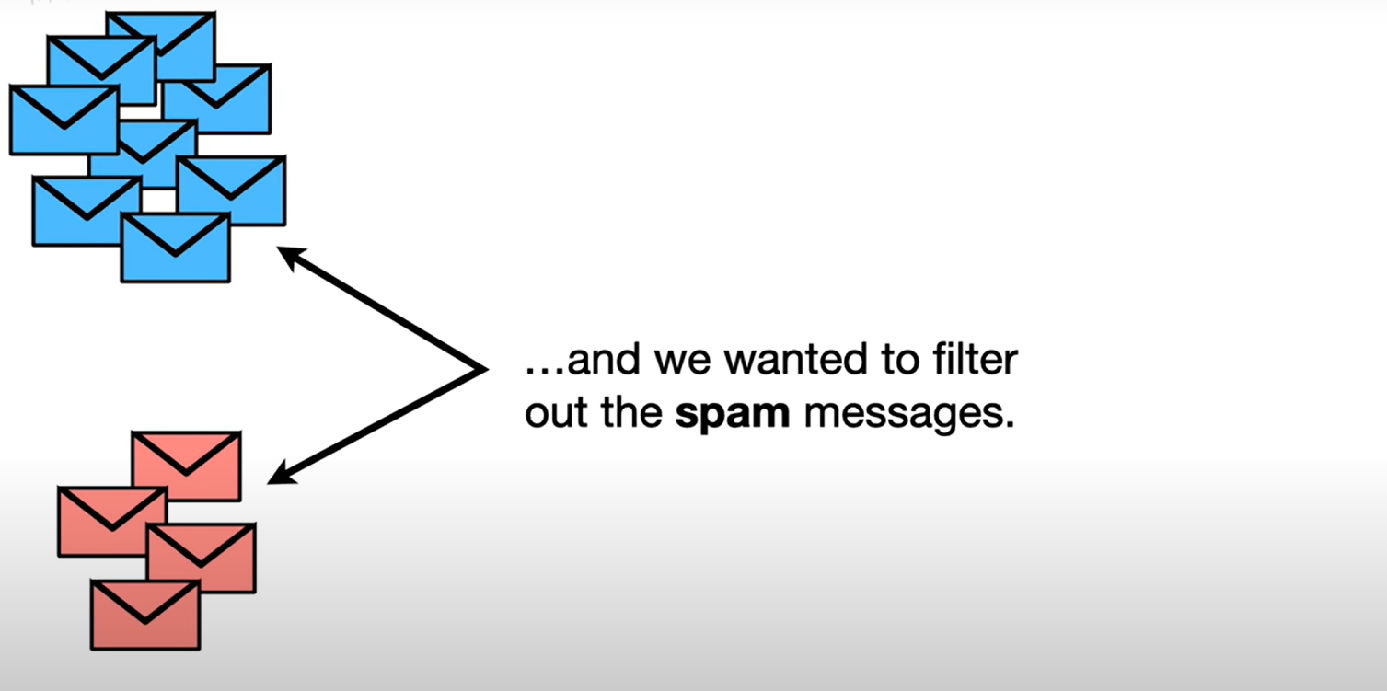
NAIVE BAYES CLASSIFIERS

Slide 16
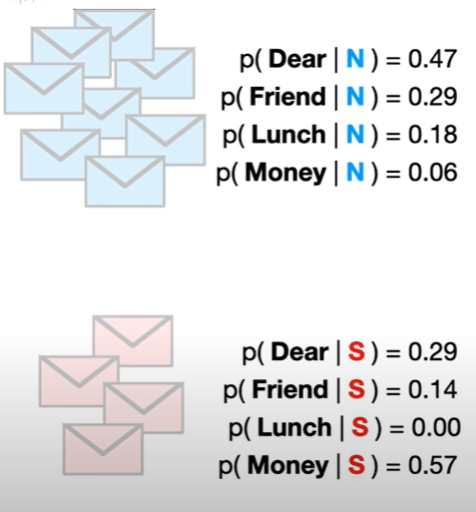
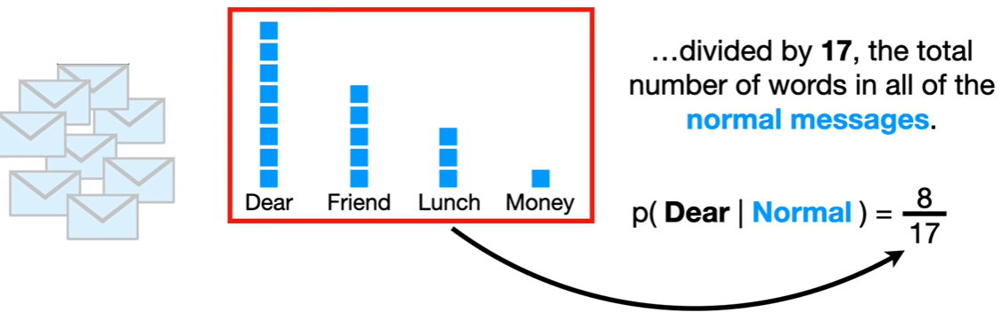
NAIVE BAYES CLASSIFIERS

Slide 17
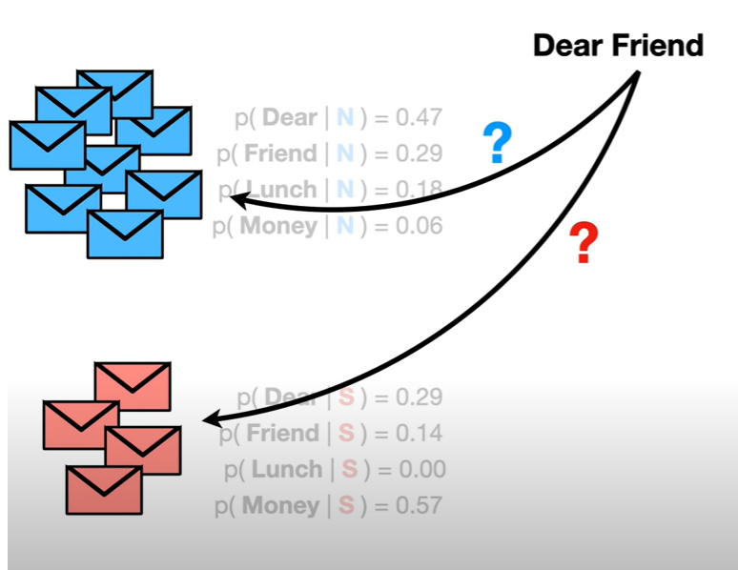
NAIVE BAYES CLASSIFIERS

Slide 18
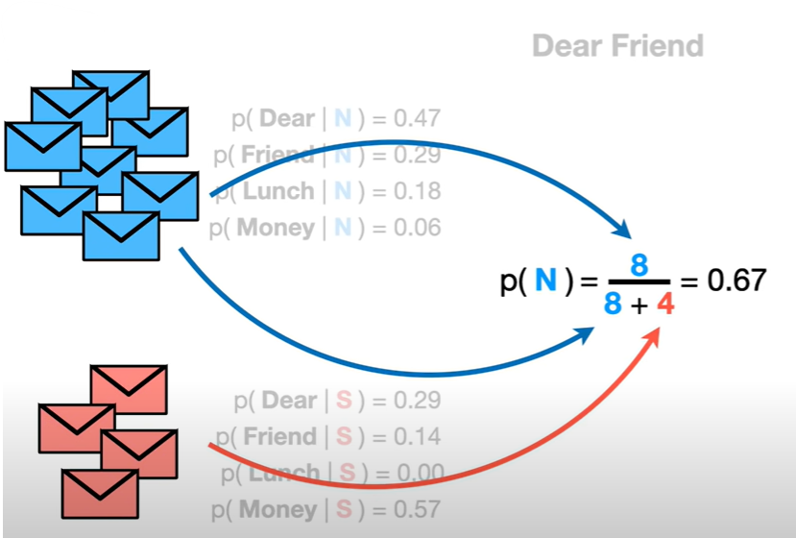
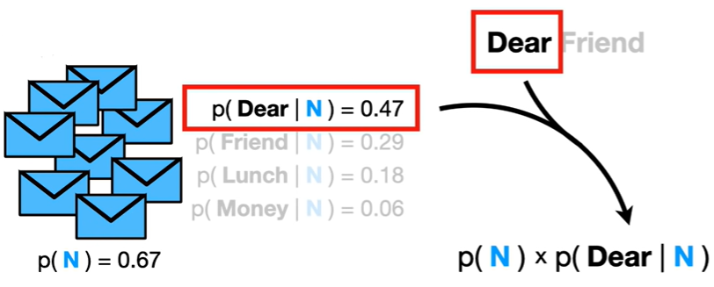
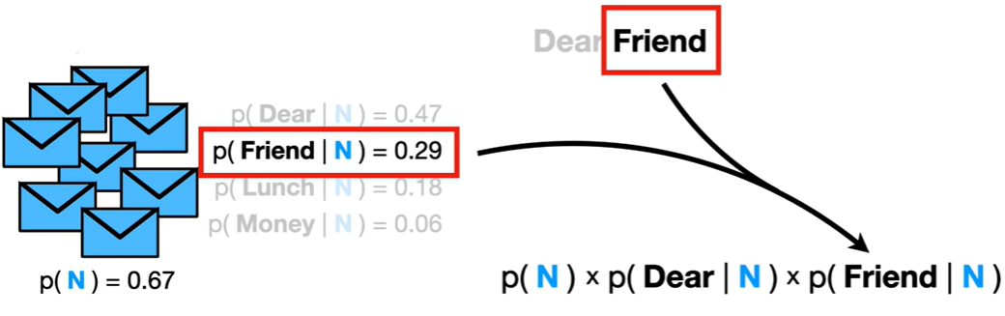
NAIVE BAYES CLASSIFIERS

Slide 19
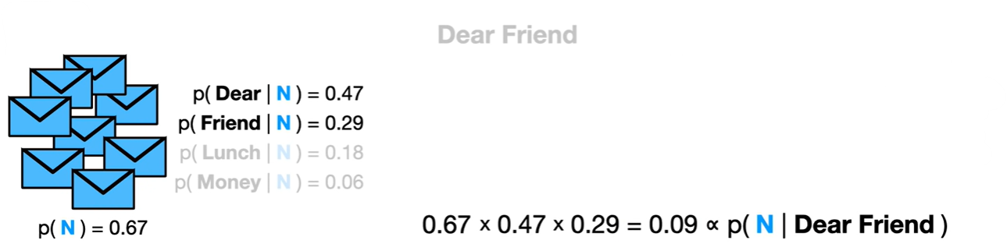
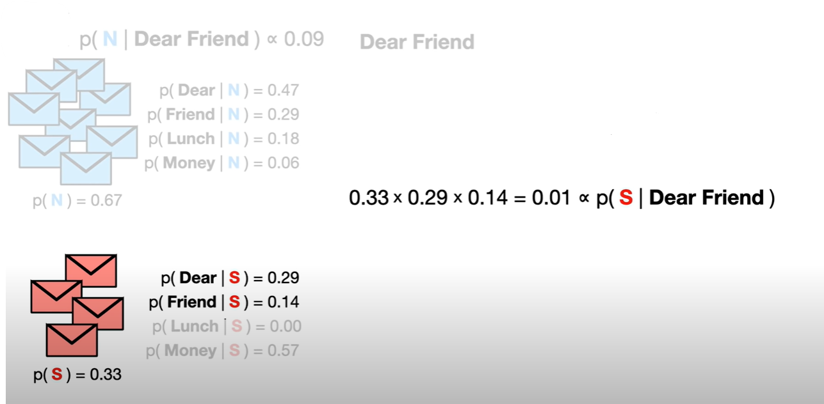
NAIVE BAYES CLASSIFIERS
0.09 > 0.01 so Dear Friend is a Normal Message

Slide 20
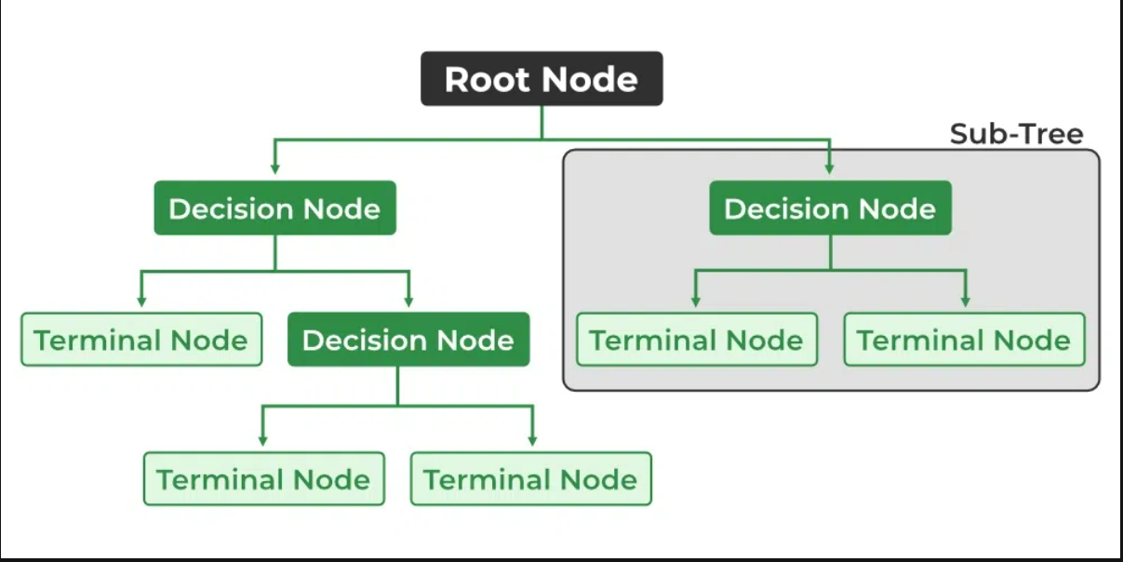
Decision Tree
Decision Trees
Goal is to make predictions by learning decision rules from data
Recursively splits data on feature values
Used for classification and regression problems
usually implement exactly the human thinking ability while making a decision, so it is easy to understand.

Slide 21
Decision Tree
Nodes: It is The point where the tree splits according to the value of some attribute/feature of the dataset
Edges: It directs the outcome of a split to the next node.
Root: This is the node where the first split takes place
Leaves: These are the terminal nodes that predict the outcome of the decision tree.

Slide 22
Decision Tree Type
Classification Tree
While building a Decision tree, the main thing is to select the best attribute from the total features list of the dataset for the root node as well as for sub-nodes. The selection of best attributes is being achieved with the help of a technique known as the Attribute selection measure (ASM).
Methods:
• Information Gain (ID3)
• GINI

Slide 23
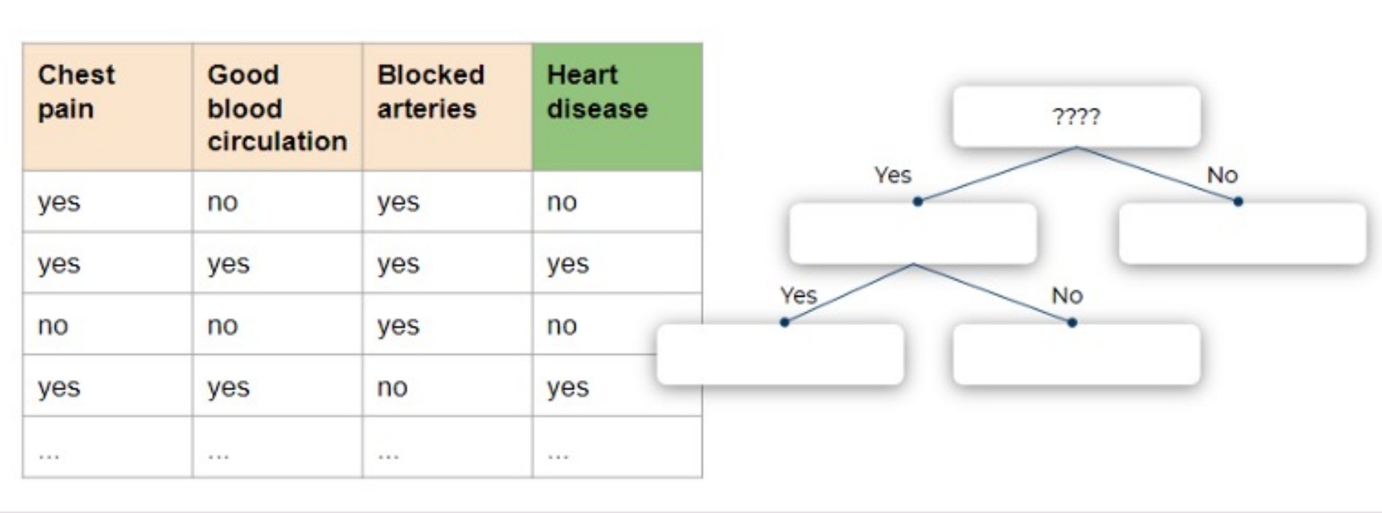
GINI

Slide 24
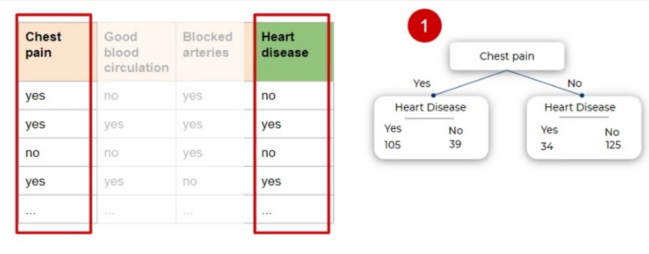
GINI

Slide 25
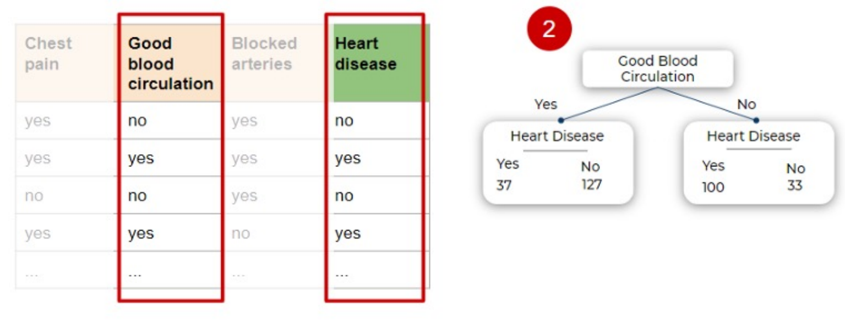
GINI

Slide 26
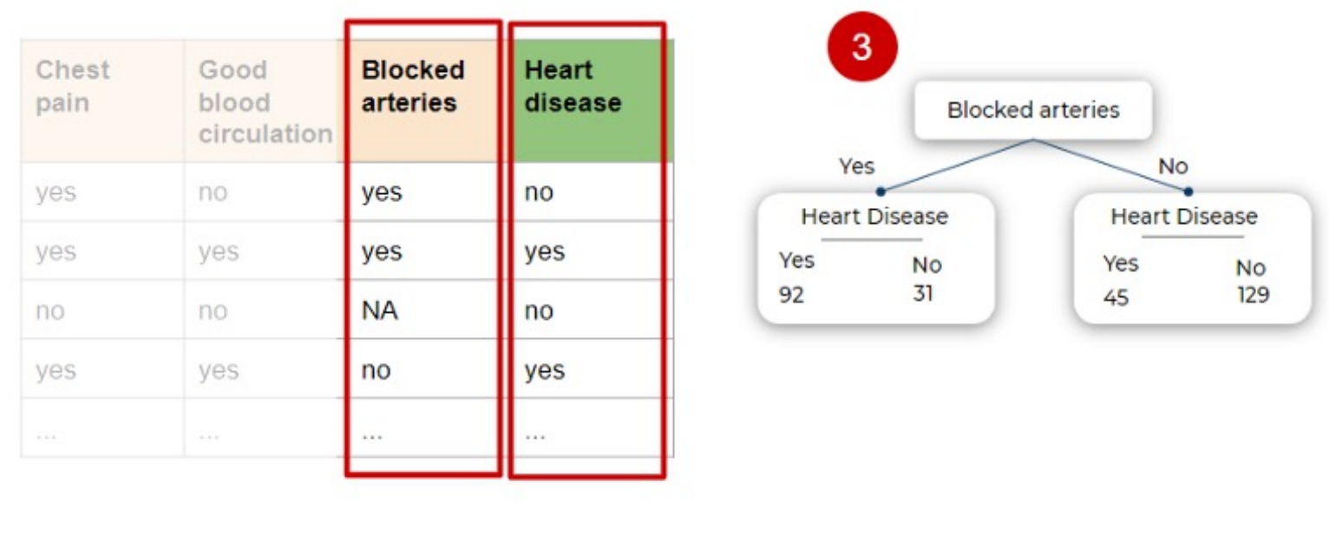
GINI

Slide 27
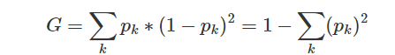
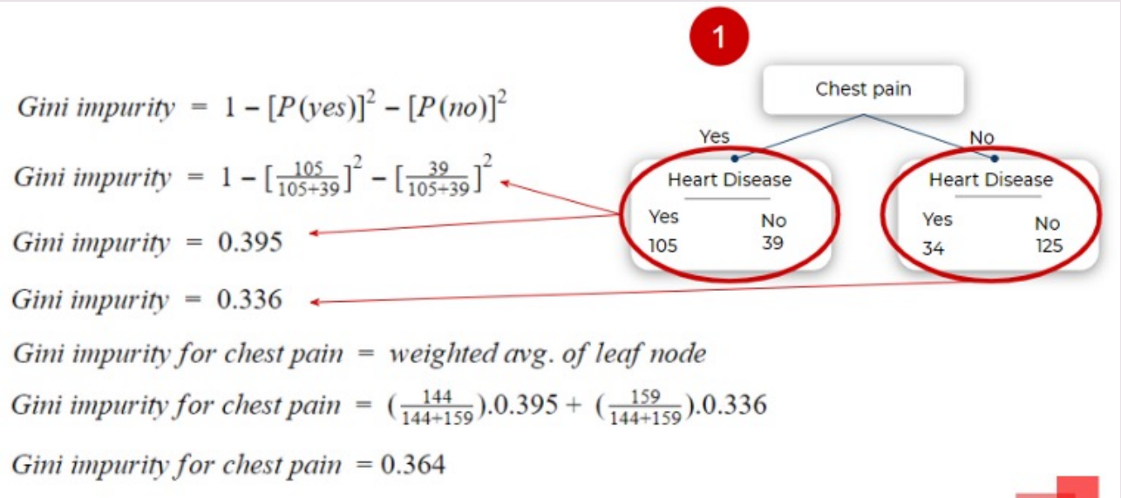
GINI
G is the Gini Impurity value
k number of classes in the data set
pk is the probability that a random element belongs to class k

Slide 28
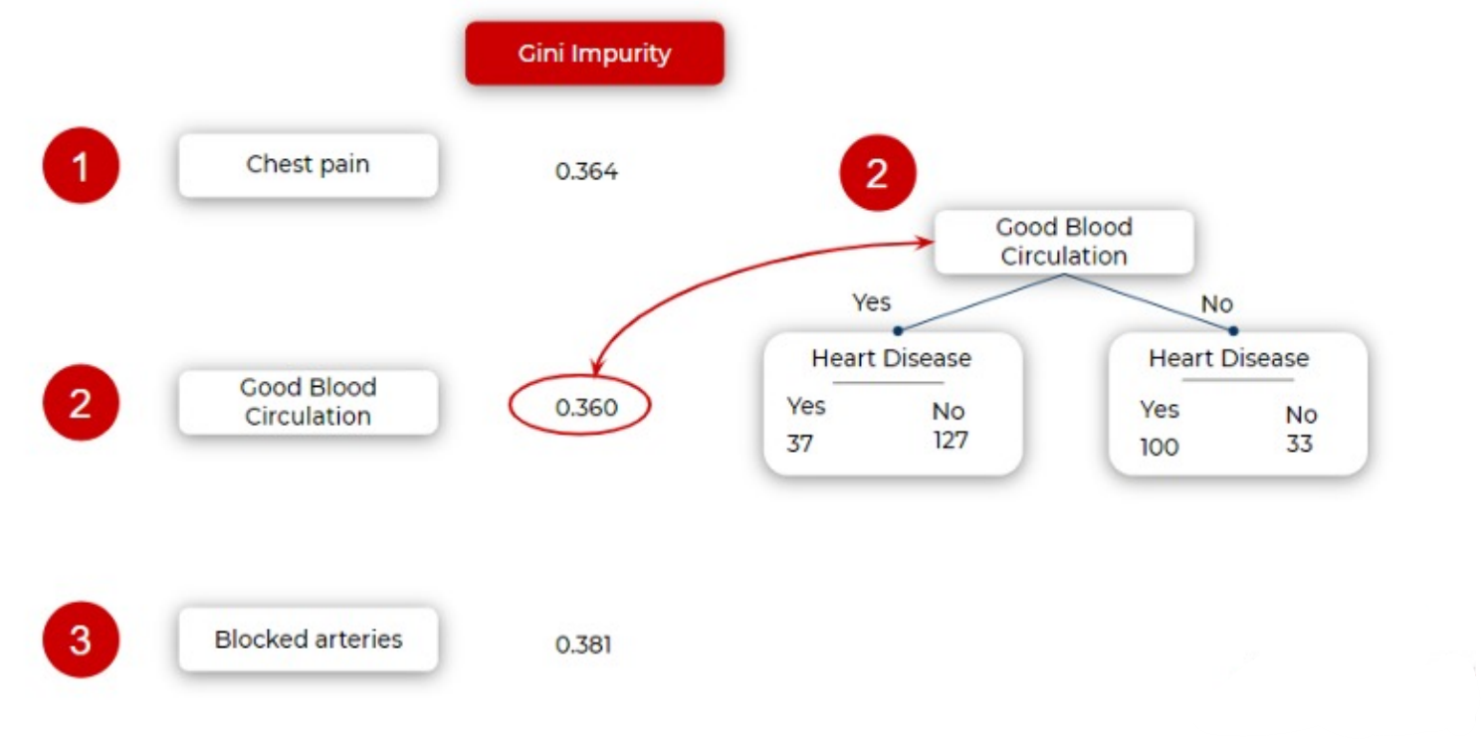
GINI

Slide 29
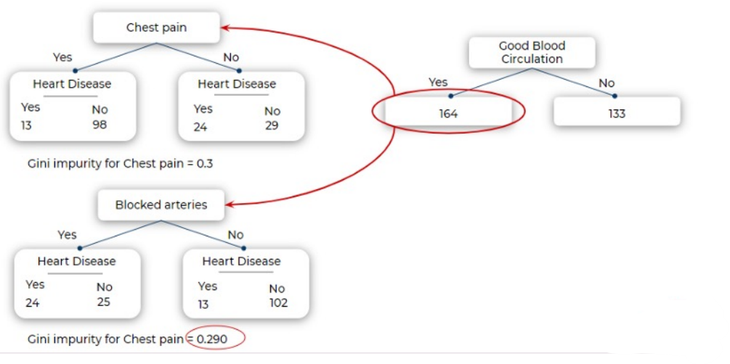
GINI

Slide 30
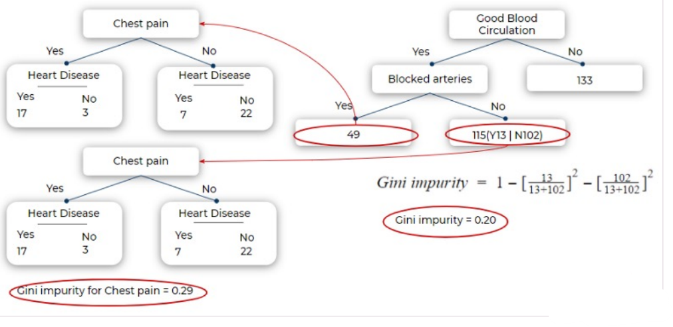
GINI

Slide 31
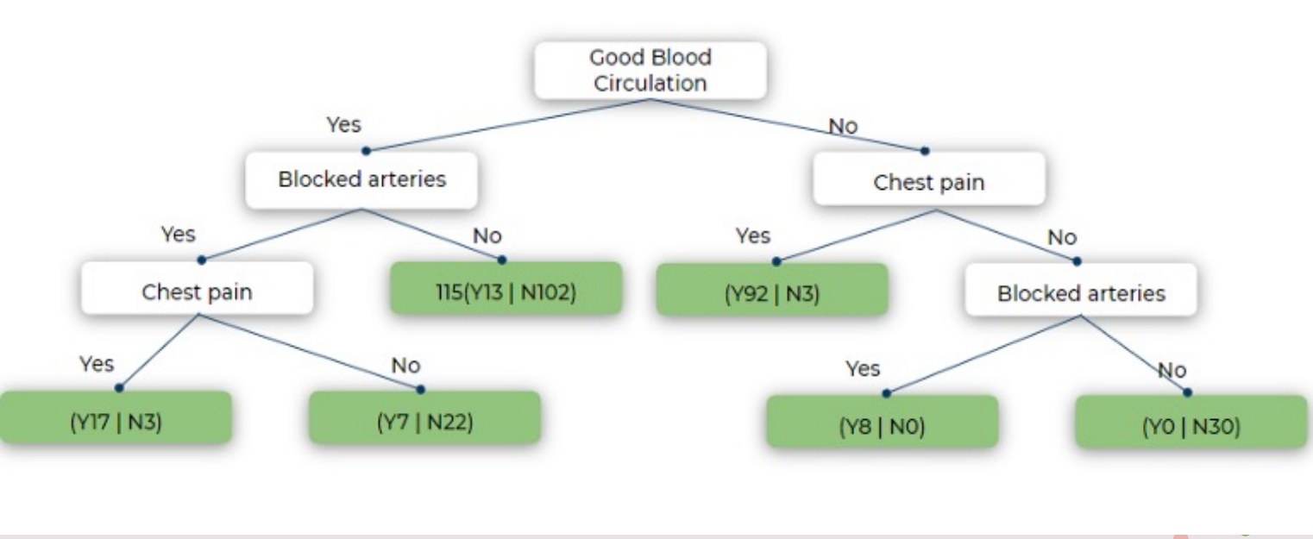
GINI

Slide 32
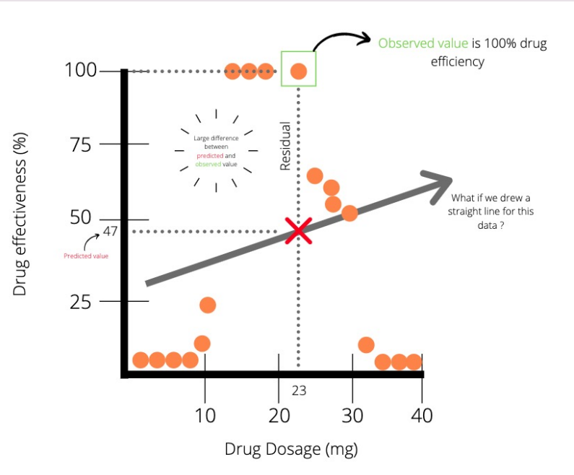
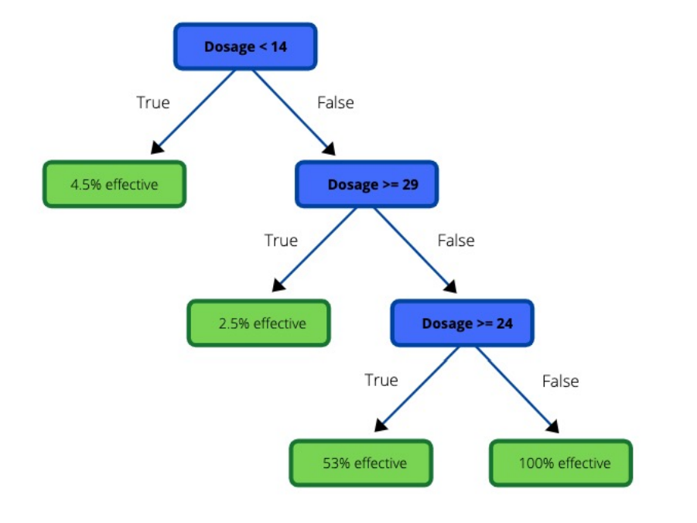
Regression Tree

Slide 33
Decision Tree
Advantages
Disadvantages
Easy to visualize and interpret
Overfitting
Not exact fit for continuous data
Useful in data exploration
Less data cleaning required
The data type is not a constraint:
It can handle both categorical and numerical

Slide 34
Chapter 2
Problem addressed : The goal is to predict whether a passenger is likely to cancel their flight or not based on various features available in the dataset. This problem is of significant importance to airline companies as it can help them understand customer behavior and optimize their operations accordingly.
Data Processing : Data preprocessing techniques used include: deleting useless columns, handling null values, encoding categorical data, normalization, splitting data, and handling class imbalance.
Models built and compared include: KNN, Logistic Regression, Decision Tree, Naive Bayes, and XGBoost.

Slide 35
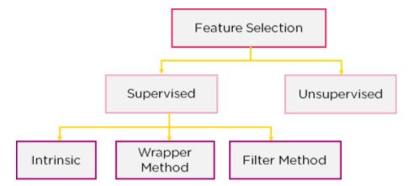
Chapter 2: Feature Selection
Feature selection models are of two types:
Supervised Models: Supervised feature selection refers to the method which uses the output label class for feature selection. They use the target variables to identify the variables which can increase the efficiency of the model
Unsupervised Models: Unsupervised feature selection refers to the method which does not need the output label class for feature selection. Using them for unlabelled data.

Slide 36
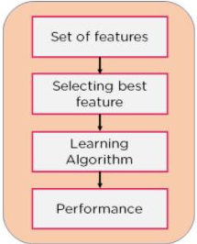
Filter Method
features are dropped based on their relation to the output, or how they are correlating to the output. Using correlation to check if the features are positively or negatively correlated to the output labels and drop features accordingly

Slide 37
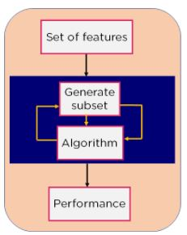
Wrapper Method
Split our data into subsets and train a model using this. Based on the output of the model, we add and subtract features and train the model again

Slide 38
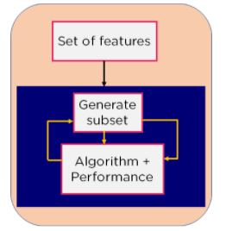
Filter Method
Combines the qualities of both the Filter and Wrapper method to create the best subset.
Method takes care of the machine training iterative process while maintaining the computation cost to be minimum. Eg: Lasso and Ridge Regression.

Slide 39
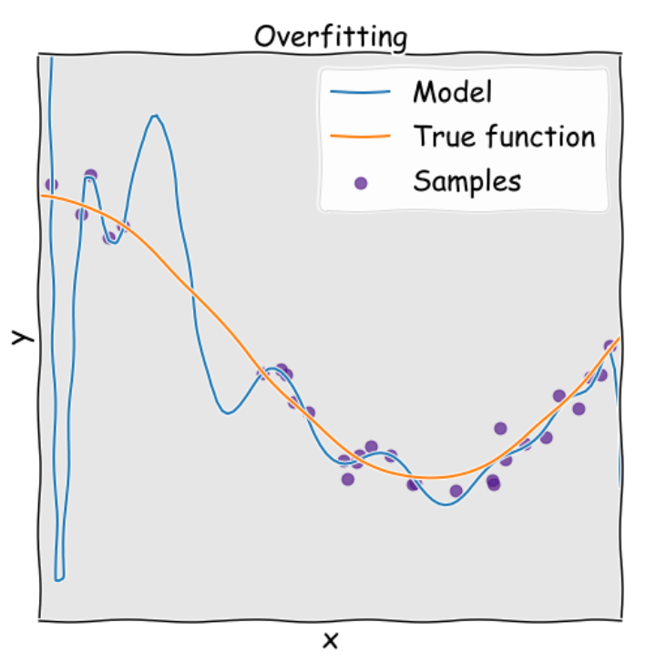
Overfitting
Overfitting refers to a model which does not generalize well from observed data to unseen data. On the other hand the model performs perfectly on the training dataset , while fitting poorly on the testing dataset.
More in-depth explanation is that the model has difficulty predicting the testing dataset which is different from the training dataset. In other words , over-fitted models tend to remember all the data, including the noise on the training dataset , rather than learning the pattern of the data

Slide 40
Cause of overfitting
Noise learning on the training set: when the training set is too small in size or has less representative data or too many noises. This situation makes the noises have great chances to be learned, and later act as a basis of predictions.
Highly complex machine learning model: the complex model (especially neural networks) tends to learn the datapoint to carefully leading to overfitting due to their extreme flexibility and capacity
hypothesis complexity: the trade-off in complexity, a key concept in statistic and machining learning, is a compromise between Variance and Bias. It refers to a balance between accuracy and consistency.

Slide 41
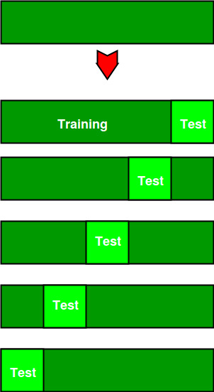
Reducing Overfitting
Cross-validation
Cross validation is a technique for evaluating machine learning models on a limited data sample. It aims to estimate how well a model will generalize to new data.
Cross-validation is a method in which we train models by splitting the dataset into training and validating sub-data . After training the model and validating the data , we continue to split the dataset in which the new training sub-dataset and the validating sub-dataset is not the same as the previous until there is no sub-dataset to be validated . Notice after a validation step will provide the error for evaluating the cross-validation score.After the cross-validation we will choose the model which have the least error

Slide 42
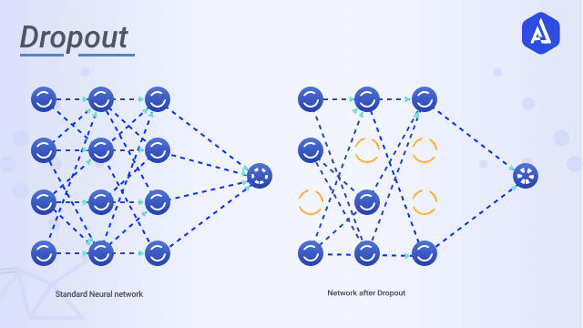
Reducing Overfitting
Regularization
Dropout
Dropout is a regularization technique that randomly sets a fraction of neuron outputs to zero during training. For example, with a dropout rate of 0.2, 20% of neurons will be "dropped out" in each training iteration.

Slide 43
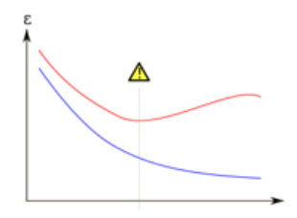
Reducing Overfitting
Early stopping
The idea of this method is we stop the training process at certain points where the models performance decline based on evaluating the model on the validation dataset

